Slide 1


Stenden Events
Presented by Group E

Slide 2
The Crew

Slide 3
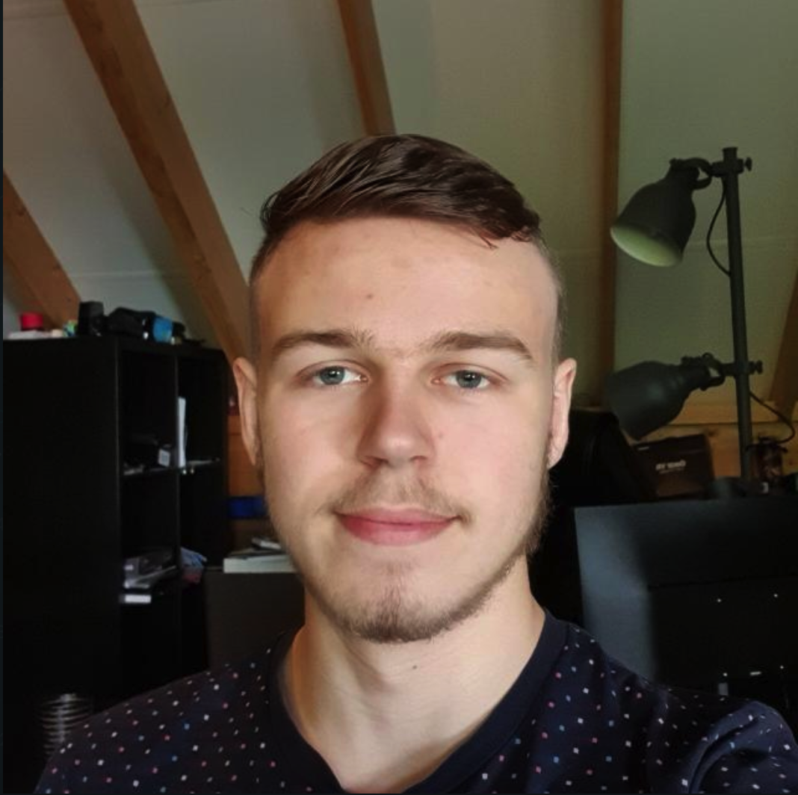
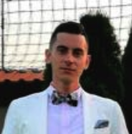
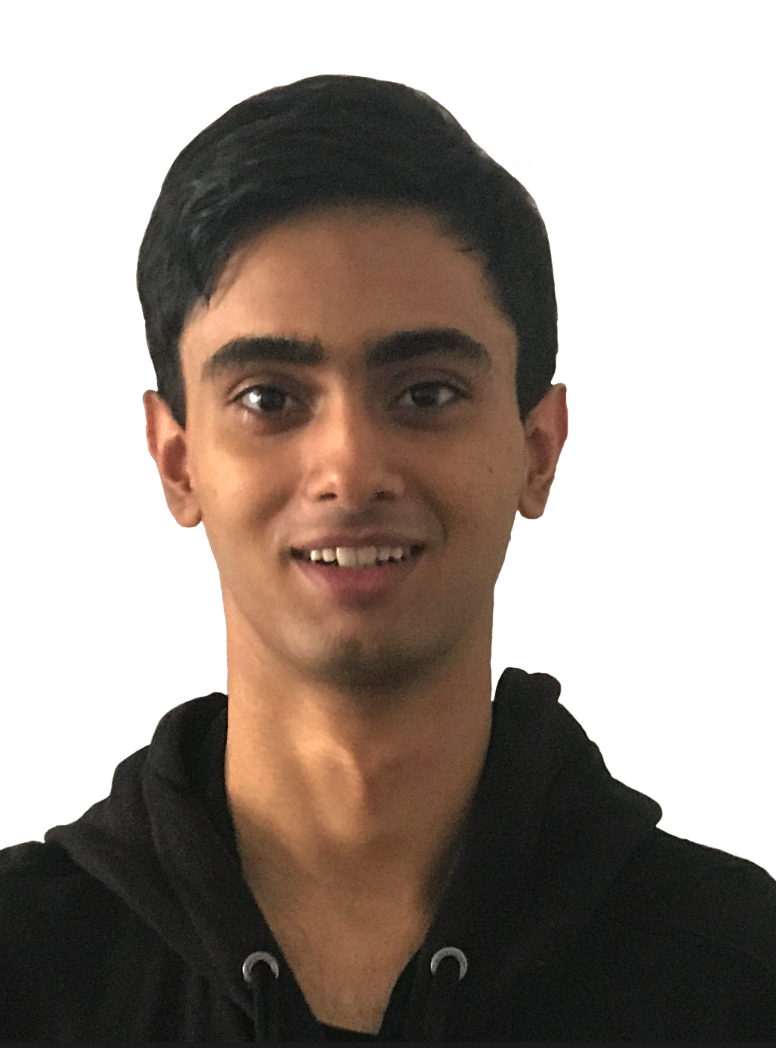
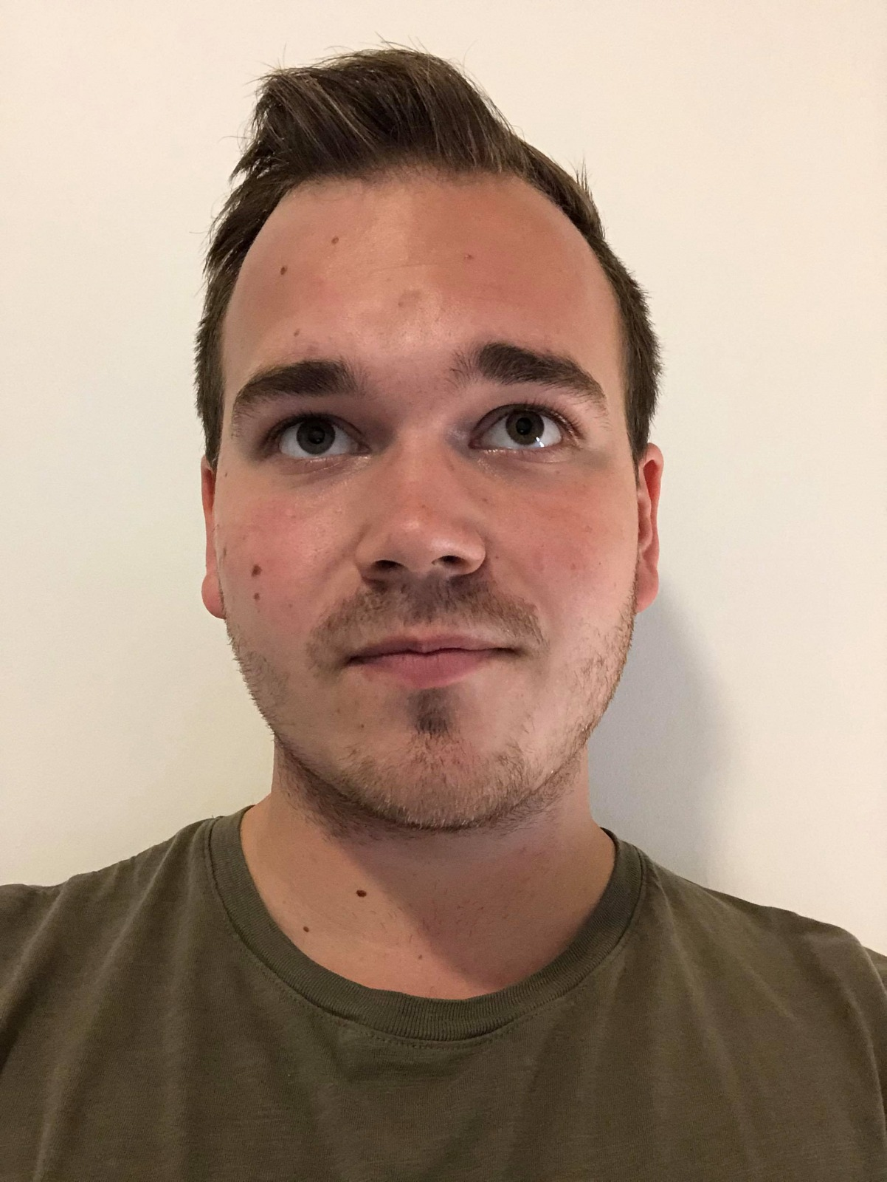
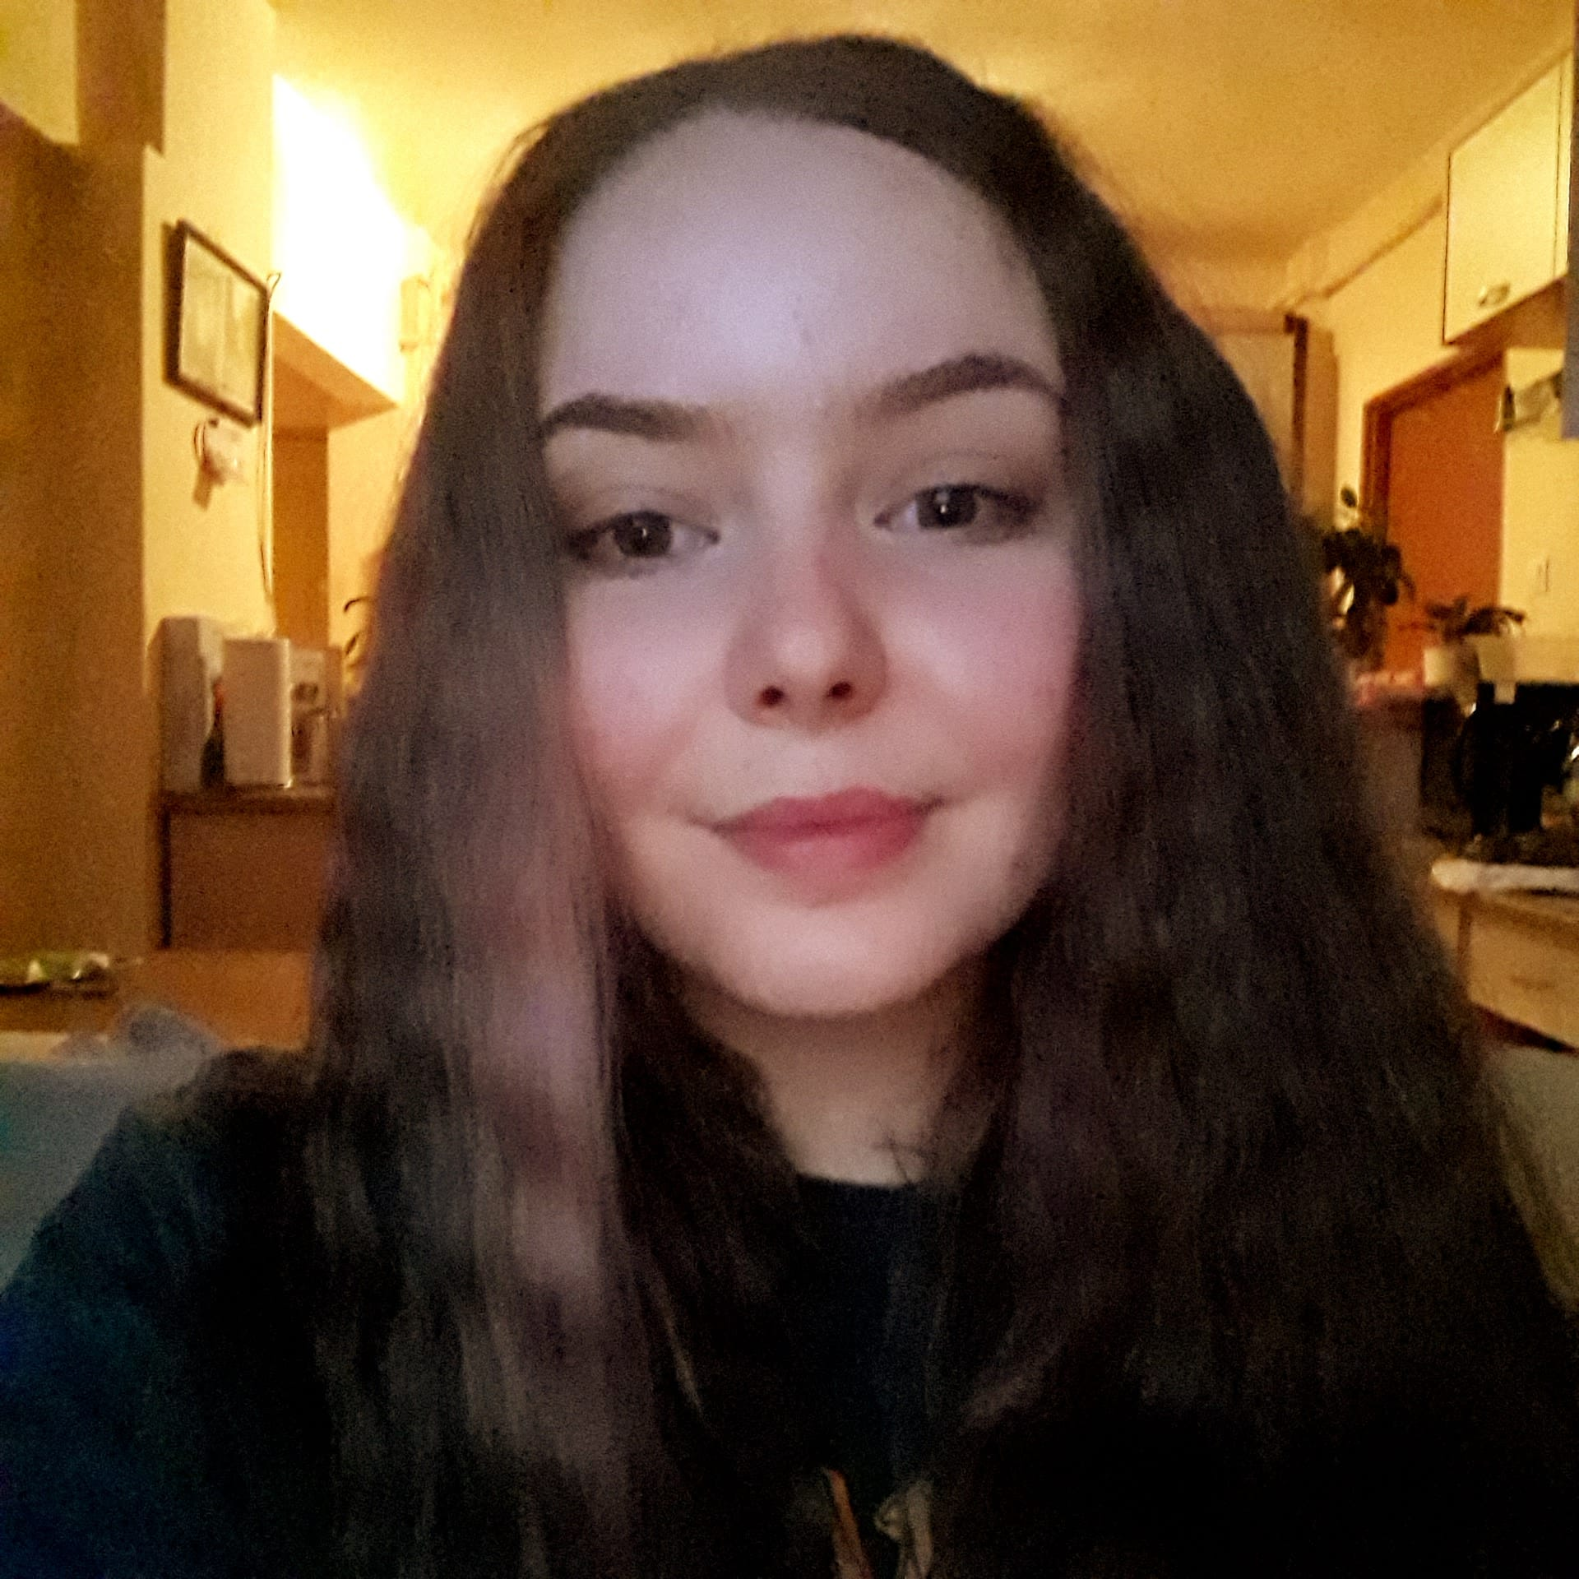
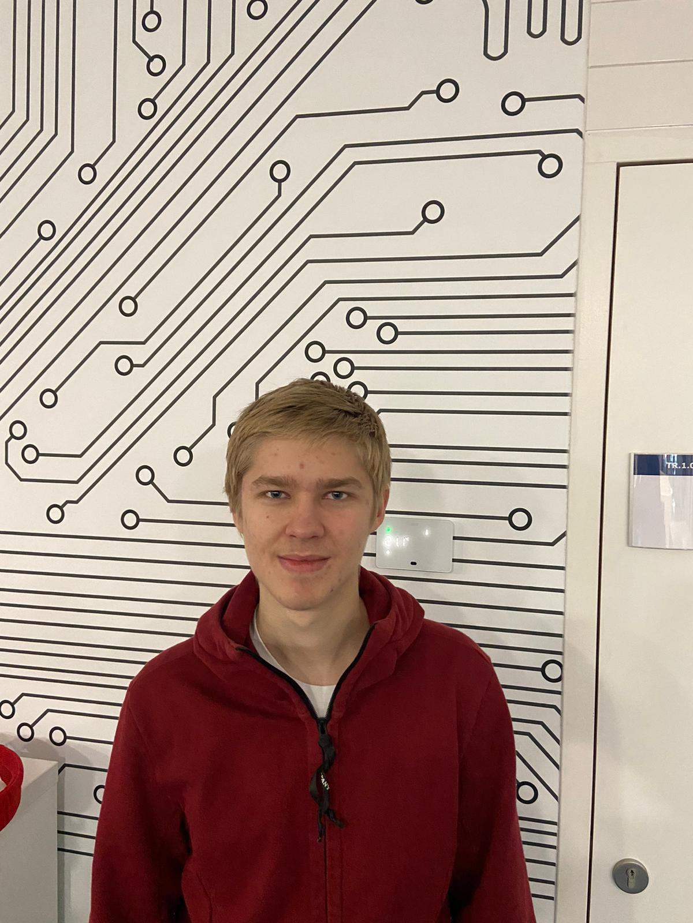
Rob Veldman
Group Leader / back-end Developer
Martin Radoychev
Location manager / Motivator / front-end Developer
Nathan p. Pais D’costa
Group Co-leader / Lead Back-end Developer
Oliver Aarland
Secretary / back-End Developer
Annie Mihaila
Designer / Quality control / Front-end Developer
Alexander Vakhrushev
Designer / Lead Front-End Developer

Slide 4
ABout Stenden events
Stenden events is a 70’s themed intranet featuring events that are organised by NHL Stenden hogeschool.

Slide 5










Platforms used for the duration of the project
Discord
WhatsApp
Teams
Github
VS Code
Trello
OneDrive
MS Word
MS Powerpoint
Keynote

Slide 6
Documents/Code sink
https://github.com/nathan-pete/Group-E

